Slide 1


Introduction to Computer Science
Reichman University
Recitation 10
Notes:
‹#›

Slide 2
Overview
Complexity
Search
Binary Search
Linked List
Node
Linked List
2 Data Node Linked List.
Notes:
‹#›

Slide 3

Complexity
Recitation 10
Notes:
‹#›

Slide 4
Complexity
There are 2 kinds of complexity.
Time
Space
When it comes to this course when we refer to complexity we refer to Time Complexity.
Notes:
‹#›

Slide 5
Complexity
Complexity is a measure used to analyze the efficiency of algorithms.
It describes the amount of time an algorithm takes to run as a function of the size of its input.
Complexity is typically expressed using Big O notation, which provides an upper bound on the growth rate of the algorithm's running time relative to the size of the input.
In simpler terms, it helps us understand how the execution time of an algorithm increases with the size of the input data. This analysis helps in comparing different algorithms and predicting their performance on large inputs.
Notes:
‹#›

Slide 6
Complexity - Examples
Constant complexity – O(1) - describes an algorithm whose execution time does not depend on the size of the input data. Regardless of the size of the input, the algorithm takes a constant amount of time to complete its execution.
Math operations (*,+,-,/,%)
Boolean operations (&&,||,!)
Logical operations (>,<,!=,== etc.)
Field access (In OOP)
Access any element in Array.
Linear complexity – O(n) - describes an algorithm whose execution time increases linearly with the size of the input. In other words, as the size of the input data increases, the time taken by the algorithm to complete its execution also increases proportionally.
Iterating over 1D array/string
Find the middle element in LinkedList
Quadratic complexity – O(n^2) - escribes an algorithm whose execution time grows quadratically with the size of the input data. In simpler terms, as the input size increases, the time taken by the algorithm to complete its execution increases quadratically, proportional to the square of the input size.
Iterating over a 2D array sized (nXn)
Notes:
‹#›

Slide 7

Binary Search
Recitation 10
Notes:
‹#›

Slide 8
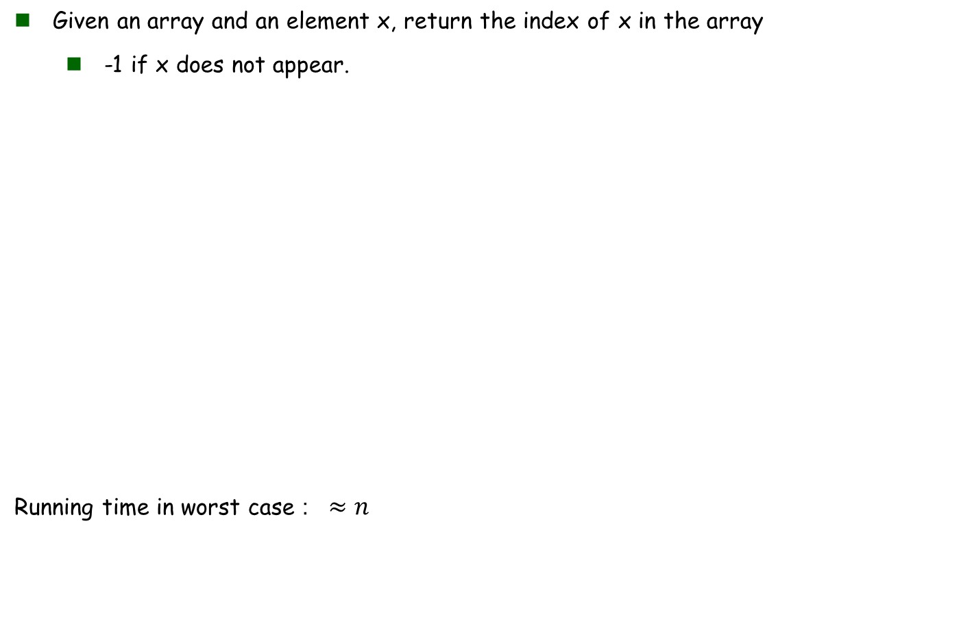
Sequential Search
public static int sequentialSearch(int [] arr, int x) {
for(int i = 0; i < arr.length; i++) {
if(arr[i] == x) {
return i;
}
}
return -1;
}
Notes:
‹#›

Slide 9
Binary Search
If the array is sorted, we can do better.
The idea is that at each step we divide the search interval in half.
Begin with an interval covering the whole array.
If the value of x is less than the item in the middle, narrow the interval to the lower half.
Otherwise narrow it to the upper half.
Repeatedly check until the value is found or the interval is empty.
Notes:
‹#›

Slide 10

Binary Search
public static int binarySearch(int[] arr, int x){
return binarySearch(arr, 0, arr.length - 1, x);
}
private static int binarySearch(int[] arr, int start, int end, int x){
if (end < start){
return -1;
}
int mid = (start + end)/2;
// If the element is present at the middle itself
if (arr[mid] == x) {
return mid;
}
if (x < arr[mid]){
return binarySearch(arr, start, mid - 1, x);
}
// else the element can only be present in right subarray
return binarySearch(arr, mid + 1, end, x);
}
Notes:
‹#›

Slide 11
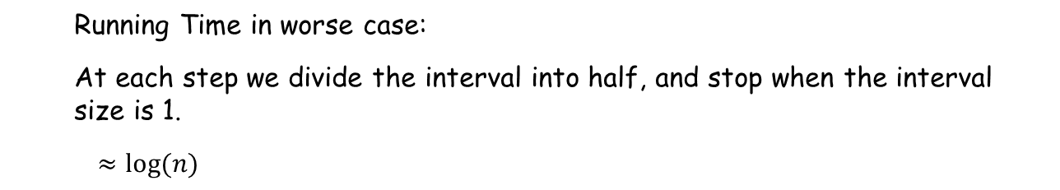
Binary Search
private static int binarySearch(int[] arr, int start, int end, int x){
if (end < start){
return -1;
}
int mid = (start + end)/2;
// If the element is present at the middle itself
if (arr[mid] == x) {
return mid;
}
if (x < arr[mid]){
return binarySearch(arr, start, mid - 1, x);
}
// else the element can only be present in right subarray
return binarySearch(arr, mid + 1, end, x);
}

Slide 12
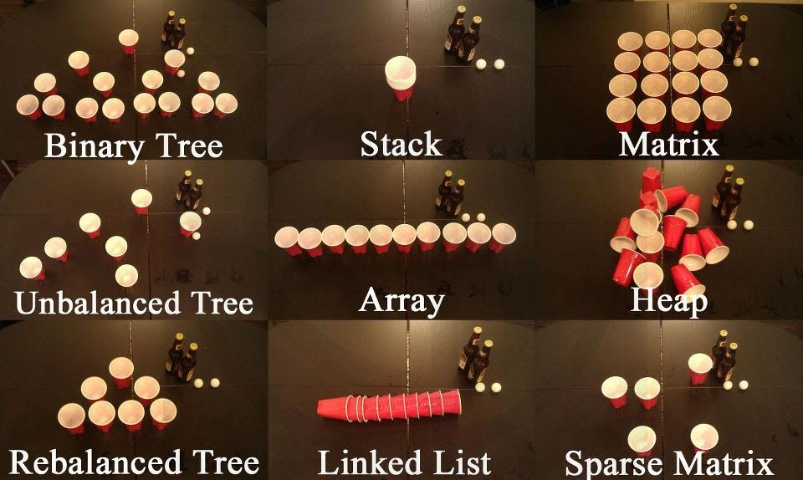
Linked Lists
Introduction to Computer Science
Reichman University
Recitation 10
Notes:
‹#›

Slide 13
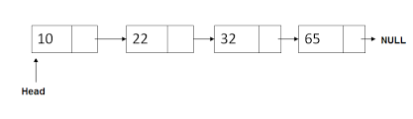
Linked Lists - overview
Linked lists are among the simplest and most common data structures.
Unlike arrays, linked lists allow us to dynamically allocate memory as needed.
This means we do not have to know in advance the size of the list.
This data structure is actually composed of 3 classes:
Node – holds one element of the list, this is where the magic happens.
LinkedList – wraps the entire list, contains functions to manipulate the list.
ListIterator- helper class for iterating over the list. Much in the same way a for loop is used for iterating over an array.
Notes:
‹#›

Slide 14
Node
The nodes are the atoms of the list.
Each node represents one link of the linked list.
Nodes usually have at lease two fields:
data – the element contained in the node. (other names: value etc.)
next – a pointer to the next node in the list. (other field Node can have: prev, left, right etc.)
This means every node in the list has ‘access’ to all succeeding nodes.
So, it is enough to know the head node, in order to know the entire list.
data
next
6
Notes:
‹#›

Slide 15
Node
/** Represents a node in a linked list. A node has a value and a pointer
* to another node. */
public class Node {
int data;
Node next;
/** Constructs a node with the given data. The new node will point to
* the given node (next). */
Node(int data, Node next) {
this.data = data;
this.next = next;
}
/** Constructs a node with the given data. The new node will point
* to null */
Node(int data) {
this(data, null);
}
}
Notes:
Need to explain why there is no public and private, same dir
the second is more common

Slide 16
Linked List
A list is composed of a sequence of nodes.
As explained before, the only field really necessary for the list is:
first/head – a pointer to the first element of the list.
In practice, we use some more ‘service’ fields to increase efficiency, such as:
size – the size of the list.
last/tail – a pointer to the last element of the list.
Note: you will not always have those fields. read the documentation.
Notes:
‹#›

Slide 17
Linked List
public class LinkedList {
private Node first;
private int size;
/** Constructs an empty list. */
public LinkedList();
/** Inserts the given element at the beginning of this list */
public void addFirst (int elem);
/** Inserts the given element at the end of this list */
public void addLast (int elem);
/** Returns the first
location of the element in this list, or -1 is no such element. */
public int indexOf (int elem);
/** Removes the first occurrence of the given element from this list. */
public void remove (int elem);
/** Returns the data at the specified position in this list. */
public int getData(int index)
// More LinkedList methods follow.

Slide 18
Question 1 – Linked List Constructor
Design a program in Java where you write a constructor method for a LinkedList class. The program doesn’t any other elements. And create an empty LinkedList
Here is the client code for help
Client code
LinkedList q = new LinkedList();
// Creates an empty list

Slide 19
Question 1 – Solution
public LinkedList () {
this.first = null;
this.size = 0;
}

Slide 20
Question 1 – solution visualization.
Client code
public LinkedList () {
this.first = null;
this.size = 0;
}
LinkedList q = new LinkedList();
// Creates an empty list
data
next
first
null
field in LL
Notes:
‹#›

Slide 21
Question 2 – addFirst
Design a program that implements the 'addFirst(int elem)' method. This method inserts an element at the beginning of a LinkedList.
Think: what are the steps required?
Here is the client code for help
Client code
LinkedList q = new LinkedList();
q.addFirst(7);
q.addFirst(3);
// Creates the list (3 7)

Slide 22
Question 2 – addFirst – Plan
Steps
1. Creating a new Node which contains the value passed through the variable ‘elem’ to the function. and store it in a variable.
Why? My object my rules. I need to wrap the data in way which can be worked with my object.
2. Assigning the new node’s pointer next to point towards the first element.
Why? If we don’t do that we will lose the data we already stored
3. Assigning the linked list first field to point toward the new node.
Why? We must connect the first field to the new first element of the list otherwise we won't have access it
4. Increase the size by 1.
Why? We maintain the correctness of the size at all time

Slide 23
Question 2 - Solution
public void addFirst(int elem) {
Node newNode = new Node(elem);
newNode.next = this.first;
this.first = newNode;
this.size++;
}
Notes:
‹#›

Slide 24
Question 2 – Solution visualization
Client code
public void addFirst(int elem) {
Node newNode = new Node(elem);
newNode.next = this.first;
this.first = newNode;
this.size++;
}
LinkedList q = new LinkedList();
q.addFirst(7);
q.addFirst(3);
// Creates the list (3 7)
line 2 client,
line 1 function
data
next
7
null
this.first
null
Notes:
‹#›

Slide 25
Question 2 – Solution visualization (Continued)
Client code
public void addFirst(int elem) {
Node newNode = new Node(elem);
newNode.next = this.first;
this.first = newNode;
this.size++;
}
LinkedList q = new LinkedList();
q.addFirst(7);
q.addFirst(3);
// Creates the list (3 7)
line 2 client,
line 2 function
data
next
7
this.first
null
Notes:
‹#›

Slide 26
Question 2 – Solution visualization (Continued)
Client code
public void addFirst(int elem) {
Node newNode = new Node(elem);
newNode.next = this.first;
this.first = newNode;
this.size++;
}
LinkedList q = new LinkedList();
q.addFirst(7);
q.addFirst(3);
// Creates the list (3 7)
line 2 client,
line 3 function
data
next
7
this.first
null
Notes:
‹#›

Slide 27
Question 2 – Solution visualization (Continued)
Client code
public void addFirst(int elem) {
Node newNode = new Node(elem);
newNode.next = this.first;
this.first = newNode;
this.size++;
}
LinkedList q = new LinkedList();
q.addFirst(7);
q.addFirst(3);
// Creates the list (3 7)
line 2 client,
line 3 function
this.first
7
null
data
next
Notes:
‹#›

Slide 28
Question 2 – Solution visualization (Continued)
Client code
public void addFirst(int elem) {
Node newNode = new Node(elem);
newNode.next = this.first;
this.first = newNode;
this.size++;
}
LinkedList q = new LinkedList();
q.addFirst(7);
q.addFirst(3);
// Creates the list (3 7)
line 3 client,
line 1 function
data
next
3
null
this.first
7
null
data
next
Notes:
‹#›

Slide 29
Question 2 – Solution visualization (Continued)
Client code
public void addFirst(int elem) {
Node newNode = new Node(elem);
newNode.next = this.first;
this.first = newNode;
this.size++;
}
LinkedList q = new LinkedList();
q.addFirst(7);
q.addFirst(3);
// Creates the list (3 7)
line 3 client,
line 2 function
data
next
3
this.first
7
null
data
next
Notes:
‹#›

Slide 30
Question 2 – Solution visualization (Continued)
Client code
public void addFirst(int elem) {
Node newNode = new Node(elem);
newNode.next = this.first;
this.first = newNode;
this.size++;
}
LinkedList q = new LinkedList();
q.addFirst(7);
q.addFirst(3);
// Creates the list (3 7)
line 3 client,
line 3 function
data
next
3
this.first
7
null
data
next
Notes:
‹#›

Slide 31
Question 2 – Solution visualization (Continued)
Client code
public void addFirst(int elem) {
Node newNode = new Node(elem);
newNode.next = this.first;
this.first = newNode;
this.size++;
}
LinkedList q = new LinkedList();
q.addFirst(7);
q.addFirst(3);
// Creates the list (3 7)
data
next
data
next
this.first
3
7
null
Notes:
‹#›

Slide 32
Question 2 Expansion - AddLast
public void addLast(int elem) {
Node cur = this.first;
while (cur.next != null) {
cur = cur.next;
}
cur.next = new Node(elem);
this.size++;
}
What is the time complexity of this functions in terms of the list size n?
Answer: O(n) since we go through the entire array, each time doing a constant number of operations
Notes:
‹#›

Slide 33
Question 3 – Remove at Index
Design a program that implements the ’removeAtIndex (int index)' method. This method removes the element in the index.
If the index is an illegal index (negative or bigger/equal than the size) return false, else return true to denote successful node removal.
Notes:
‹#›

Slide 34
Question 3 – Solution (two pointers)
public boolean removeAtIndex(int index) {
if (index < 0 || index >= this.size || this.first == null) {
// Index out of bounds or list is empty
return false;
}
if (index == 0) {
this.first = this.first.next; // Remove first
return true;
}
// Traverse the list to find the node at the given index
Node prev = null;
Node current = this.first;
for (int i = 0; i < index; i++) {
prev = curr;
current = current.next;
}
// Remove the node at the given index
prev.next = current.next;
this.size--; // Decrease the size of the list
return true;
}
Notes:
‹#›

Slide 35
Question 3 – Solution (single pointer)
public boolean removeAtIndex(int index) {
if (index < 0 || index >= this.size || this.first == null) {
// Index out of bounds or list is empty
return false;
}
if (index == 0) {
this.first = this.first.next; // Remove first
return true;
}
// Traverse the list to find the node at the given index
Node current = this.first;
for (int i = 0; i < index - 1; i++) {
current = current.next;
}
// Remove the node at the given index
current.next = current.next.next;
this.size--; // Decrease the size of the list
return true;
}
Notes:
‹#›

Slide 36
Question 4 - Contains
The function contains(int elem) returns true if this list contains the specified element.
How can we make this recursive?
What extra parameters will the recursion need?
Notes:
‹#›

Slide 37
Question 4 – Solution
public boolean contains (int e) {
return this.contains(e, this.first);
}
private boolean contains (int e, Node current) {
if (current == null){
return false;
}
if (current.data == e){
return true;
}
return this.contains(e, current.next);
}
Notes:
‹#›

Slide 38
Question 4, Expansion 1 - IndexOf
The function indexOf(int e) returns the index of the first appearance the given element appears in.
If the element doesn’t appear in the list, returns -1.
Again, how can we make this recursive?
Notes:
‹#›

Slide 39
Question 4, Expansion 1 - Solution
public int indexOf (int e){
if (!this.contains(e)) {
return -1;
}
return this.indexOf(e, this.first);
}
private int indexOf (int e, Node current){
if (current.data == e){
return 0;
}
return 1 + this.indexOf(e, current.next);
}
Notes:
‹#›

Slide 40
Question 5 - Get
The function get(int index) returns the element at the given index.
The function throws an exception for illegal indices.
Notes:
‹#›

Slide 41
Question 5 – Solution
public int get(int index){
if (index >= this.size || index < 0){
throw new IndexOutOfBoundsException("illegal index " + index);
}
Node current = this.first;
for (int i = 0; i < index; i++) {
current = current.next;
}
return current.data;
}
Notes:
‹#›

Slide 42
Question 6 - ToArray
The function toArray() returns the elements of the list in an array. In the same order the elements appear in the list.
Notes:
‹#›

Slide 43
Question 6 - Solution
public int[] toArray() {
int[] arr = new int[this.size];
Node cur = this.first;
for (int i = 0; i < arr.length; i++) {
arr[i] = cur.data;
cur = cur.next;
}
return arr;
}
Notes:
‹#›

Slide 44
Question 7 - Add
The function add(int index, int e) adds a given element at a given index.
Note that adding an element requires direct access to the nodes.
Notes:
‹#›

Slide 45
Question 7 - Solution
public void add(int index, int e) {
if (index < 0 || index > this.size) {
throw new IndexOutOfBoundsException("illegal index " + index);
}
if (index == 0) {
this.addFirst(e); // adds to first
return;
}
if (index == this.size) {
this.addLast(e); // adds to last
return;
}
Node insert = new Node(e);
Node prev = null;
Node current = this.first;
for (int i = 0; i < index; i++) {
prev = current;
current = current.next;
}
prev.next = insert;
insert.next = current;
this.size++;
}
Notes:
‹#›

Slide 46
Linked Lists – List Operations
Introduction to Computer Science
Reichman University
Recitation 10
Notes:
‹#›

Slide 47
Question 8 - Reverse list
Design a program which reverses the order of the elements in the list. Without changing the original list.
Note: You may assume that you are in LinkedList class
example :
Before:
After:
3
4
5
5
4
3
Notes:
‹#›

Slide 48
Question 8 – Solution
public LinkedList reverse() {
Node cur = this.first;
LinkedList rev = new LinkedList();
while (cur != null){
rev.addFirst(cur.data);
cur = cur.next;
}
return rev;
}

Slide 49
Question 8 – Solution (in-place)
public void reverse() {
if (this.first != null) {
Node prev = this.first;
Node cur = prev.next
prev.next = null;
while (cur != null){
Node tmp = cur.next;
cur.next = prev;
prev = cur;
cur = tmp;
}
this.first = prev;
}
}

Slide 50
Question 9 - Linked List - SubList
In the next question we will build a variation of the function str.substring(int start, int end) but instead of working on a String we will work on a list.
Given a Linked List and 2 indices (i,j) and i<=j we will return the sublist which starts at the i’th index and ends the j’th index (not included)

Slide 51
Question 9 – Solution
public LinkedList subList(int start, int end) {
if (start < 0 || end >= this.size || start > end) {
throw new InvalidParameterException();
}
Node cur = this.first;
LinkedList sub = new LinkedList();
for (int i = 0; i < this.size; i++) {
if (start <= i && i < end) {
sub.addLast(cur.data);
}
cur = cur.next;
}
return sub;
}
How many steps did this take.
assuming the only two fields of LinkedList are first and size?

Slide 52
Question 9 – Solution
public LinkedList subList(int start, int end) {
if (start < 0 || end >= this.size || start > end) {
throw new InvalidParameterException();
}
Node cur = this.first;
LinkedList sub = new LinkedList();
for (int i = 0; i < this.size; i++) {
if (start <= i && i < end) {
sub.addLast(cur.data);
}
cur = cur.next;
}
return sub;
}
How many steps did this take. O(n^2)
every addLast method takes O(n). done n times therefore
n * O(n) = O(n^2)

Slide 53
Question 9 – SubList
public LinkedList subList(int start, int end) {
if (start < 0 || end >= this.size || start > end) {
throw new InvalidParameterException();
}
Node cur = this.first;
LinkedList sub = new LinkedList();
for (int i = 0; i < this.size; i++) {
if (start <= i && i < end) {
sub.addLast(cur.data);
}
cur = cur.next;
}
return sub;
}
Can we improve that? How?
Yes, there 2 options:
Shortening the complexity of addLast by adding and maintaining a last field.
Using different functions which cost less!

Slide 54
Question 9, Expansion 1 – Solution
public LinkedList subList(int start, int end) {
if (start < 0 || end > this.size || start > end) {
throw new InvalidParameterException();
}
Node cur = this.first;
LinkedList sub = new LinkedList();
for (int i = 0; i < this.size; i++) {
if (start <= i && i < end) {
sub.addFirst(cur.data);
}
cur = cur.next;
}
return sub.reverse();
}
public LinkedList reverse() {
Node cur = this.first;
LinkedList rev = new LinkedList();
while (cur != null){
rev.addFirst(cur.data);
cur = cur.next;
}
return rev;
}

Slide 55
Question 9, Expansion 1 – Solution
public LinkedList subList(int start, int end) {
if (start < 0 || end > this.size || start > end) {
throw new InvalidParameterException();
}
Node cur = this.first;
LinkedList sub = new LinkedList();
for (int i = 0; i < this.size; i++) {
if (start <= i && i < end) {
sub.addFirst(cur.data);
}
cur = cur.next;
}
return sub.reverse();
}
public LinkedList reverse() {
Node cur = this.first;
LinkedList rev = new LinkedList();
while (cur != null){
rev.addFirst(cur.data);
cur = cur.next;
}
return rev;
}
Constructor call + field call + boolean checks (first 4 lines) -> O(1)
addFirst -> O(1)
But we use it for every element in the list (in the worst case scenario), the operation was done n times therefore-> O(1) * n = O(n)
reverse is done in the end and not for every element. If we look in the implementation we did there and we also used addFirst for every element of the list thefore -> O(1) * n = O(n)
Total: O(1) + O(n) + O(n) = O(n)
we may have done more ops but each one was ‘cheaper’ in running time.

Slide 56
Question 10 - Linked List - Equals
Given 2 String linked lists, build a function which return true if the elements of the lists are appearing in the same order.

Slide 57
Question 10 - Solution
public boolean equals(LinkedList other) {
if (this.size != other.getSize()) {
return false;
}
Node myCur = this.first;
Node otherCur = other.first;
while (myCur != null && otherCur != null) {
if (myCur.data != otherCur.data) {
return false;
}
myCur = myCur.next;
otherCur = otherCur.next;
}
return true;
}

